Slide 1
data
machine
learning
posterior
prior
model
applications
trial
design
actions

Slide 2
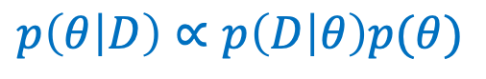
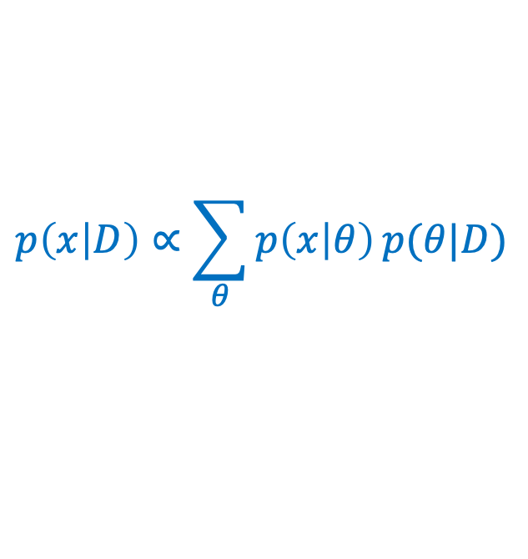
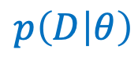
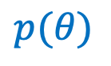
data
machine
learning
posterior
$$p\left(D | θ\right)$$
$$p\left(θ | D\right)∝p\left(D | θ\right)p(θ)$$
prior
model
applications
$$p(θ)$$
$$p\left(x | D\right)∝\sum_{θ}{p\left(x | θ\right)}p(θ|D)$$
trial
design
(for prediction)
actions

Slide 3
data
machine
learning
posterior
prior
model
applications
trial
design
actions
engineering
scientific inquiry loop

Slide 4
data
machine
learning
posterior
prior
model
trial
design
actions
agent

Slide 5
“sensory” data
machine
learning
posterior
“reward” data
prior
model
trial
design
actions
agent

Slide 6
General framework
Specific example
“sensory” data
data
machine
learning
posterior
machine
learning
posterior
“reward” data
prior
prior
model
model
trial
design
trial
design
actions
actions
agent
agent

Slide 7
compressed
(encoded)
original
decoded

